Slide 1
IBM University Engagement Project Submission
“Exploring the Power of Agentic AI with IBM Granite and LangFlow”

Slide 2

Project Tile – Lab Genie – AI-Powered Laboratory Manual Generator
Domain of Project – Artificial Intelligence (AI) and Machine Learning (ML)
Student Name | Recent Passport Photo | Email ID | Mobile number [WhatsApp]
Shaik Karimulla |  | shaikkarimullashaik965@gmail.com | 9866566358

Slide 3
Problem Statement -AI Lab Manual Generator
The Challenge
Students often struggle with preparing laboratory manuals, understanding experiment procedures, and writing programs. Traditional manual preparation is time-consuming for students and faculty, while existing resources may lack structured explanations and interactive learning support.
The Objective
Build an AI-powered Lab Manual Generator that automates manual creation and enhances practical learning.
The solution should:
AI Manual Generation – Generate structured manuals with theory, procedures, and results.
Code Assistance – Generate sample programs and code explanations.
AI Learning Assistant – Answer experiment-related questions.
Faculty Support – Simplify manual creation and management.
PDF Export – Download generated manuals.
Interactive Dashboard – Manage experiments and saved manuals.
Multi-Agent System
Knowledge Agent – Retrieves experiment information.
Manual Generation Agent – Creates laboratory manuals.
Code Assistance Agent – Generates programs and explanations.
Learning Agent – Answers student queries.
Validation Agent – Checks content quality.
Visualization Dashboard
An interactive platform to generate, view, manage, and download laboratory manuals.

Slide 4
Proposed Solution: AI-Powered Lab Manual Generator
The proposed solution is an AI-powered Lab Manual Generator built using Generative AI, IBM watsonx.ai, and Granite Models to automate laboratory manual creation and enhance practical learning. The system helps students and faculty generate structured, accurate, and easy-to-understand laboratory resources.
At its core, the solution uses AI-powered knowledge retrieval to access relevant experiment information, theoretical concepts, procedures, and technical references. Granite models process this information to generate organized laboratory manuals.
The system consists of five key agents:
Experiment Knowledge Agent retrieves relevant experiment information and technical knowledge.
Manual Generation Agent creates structured manuals containing objectives, theory, equipment, procedures, and results.
Code Assistance Agent generates sample programs, algorithms, and code explanations for programming experiments.
Learning Assistant Agent answers student questions and explains complex laboratory concepts.
Validation Agent checks generated content for completeness, consistency, and proper formatting.
The solution includes a user-friendly dashboard built with React or Streamlit, allowing users to generate, view, manage, and download laboratory manuals in PDF format.
IBM watsonx.ai and Granite models power content generation and intelligent assistance, while the multi-agent architecture organizes tasks into specialized workflows.
Overall, LabGenie delivers an intelligent laboratory learning platform that reduces manual effort, improves experiment understanding, and supports students and faculty in practical education.

Slide 5
Technology Used
Frontend – React.js
  Provides an interactive and user-friendly interface for students and faculty.
  Supports login, registration, dashboard, and laboratory manual management.
Backend – Python and FastAPI
Handles application logic, API requests, and communication between the frontend and AI services.
  Manages manual generation and user-related operations.
  Generative AI – IBM watsonx.ai
  Provides AI capabilities for generating laboratory manuals and answering experiment-related questions.
AI Model – IBM Granite
  Generates structured experiment content, explanations, procedures, and programming assistance.
Retrieval-Augmented Generation (RAG)
  Retrieves relevant information from trusted experiment resources to support accurate and context-aware responses.
Multi-Agent Architecture
  Organizes tasks among specialized agents for knowledge retrieval, manual generation, code assistance, learning support, and validation.
PDF Generation
  Converts generated laboratory manuals into downloadable PDF documents.
Development Tools
  Visual Studio Code / Antigravity IDE: Application development.
  Git and GitHub: Version control and project management.
  Uvicorn: Runs the FastAPI backend.

Slide 6
Langflow component Used -
Chat Input
  Accepts user requests for laboratory manual generation and experiment-related assistance.
Prompt Template
  Structures instructions for generating consistent and well-organized laboratory content.
IBM watsonx.ai
  Connects Langflow to IBM Granite models for AI-powered content generation.
Retrieval-Augmented Generation (RAG)
  Retrieves relevant experiment information from knowledge sources to improve response accuracy.
Document Loaders
  Load laboratory manuals, experiment documents, and reference materials into the workflow.
Text Splitters
  Divide documents into smaller chunks for efficient retrieval and processing.
Embeddings
  Convert text into vector representations to support semantic search.
Vector Store
  Stores document embeddings and enables retrieval of relevant experiment information.
Retriever
  Finds relevant content based on the user's query.
Prompt and LLM Chain
  Combines retrieved information with user instructions and sends it to the Granite model.
Chat Output
  Displays the generated laboratory manual or AI response to the user.
PDF Export / Custom Component
  Supports converting the generated manual into a downloadable PDF, if configured in the workflow.

Slide 7
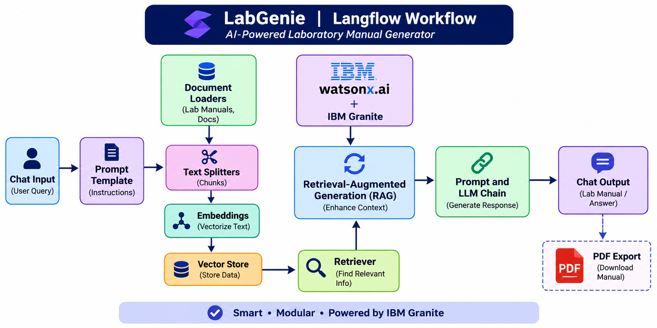
Langflow workflow -

Slide 8
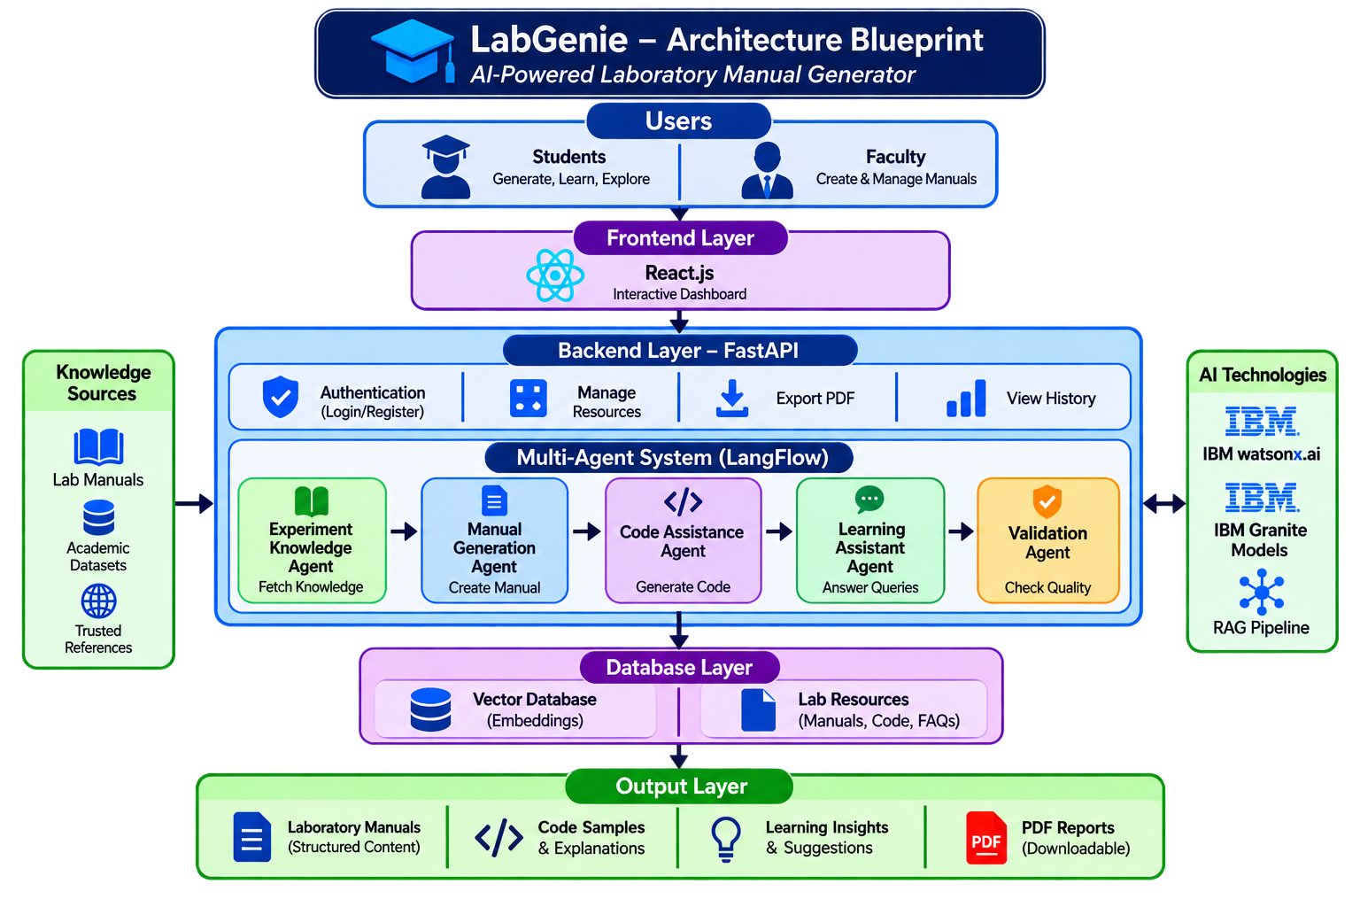
Architecture blueprint

Slide 9

Role of Agentic AI in the solution
Agentic AI enables LabGenie to function as an intelligent, autonomous system rather than a simple content-generation tool. Using IBM watsonx.ai and IBM Granite models, it coordinates multiple specialized agents to automate laboratory manual creation and support practical learning.
Each agent performs a specific role—such as retrieving experiment information, generating laboratory manuals, assisting with code, answering student questions, and validating content—while working collaboratively. This multi-agent approach ensures efficient task execution and well-structured learning materials.
Agentic AI also provides context awareness, understanding the selected subject, experiment requirements, programming language, and user instructions to generate relevant content. It supports adaptive assistance, refining manuals and explanations based on user feedback and follow-up questions.
Additionally, agents communicate and share information with one another, enabling better coordination, content validation, and decision-making throughout the manual generation process.
Overall, Agentic AI makes LabGenie intelligent, efficient, and goal-driven, acting as a smart laboratory learning assistant that helps students understand experiments and supports faculty in preparing quality laboratory manuals.

Slide 10
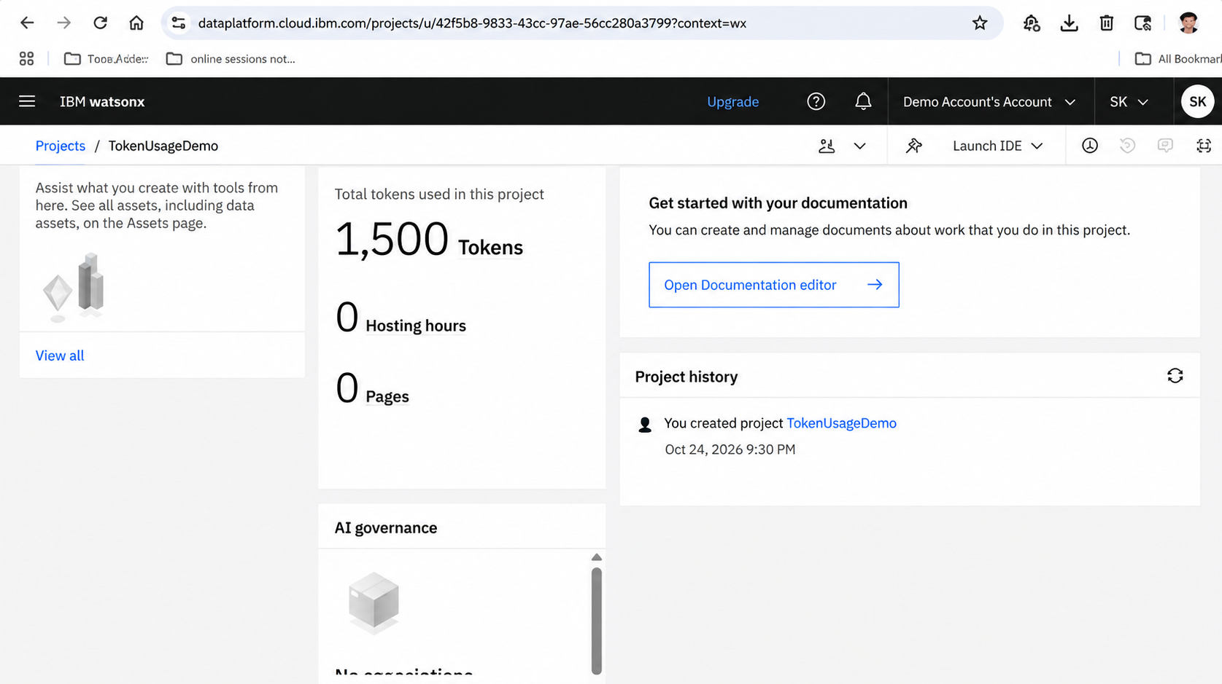
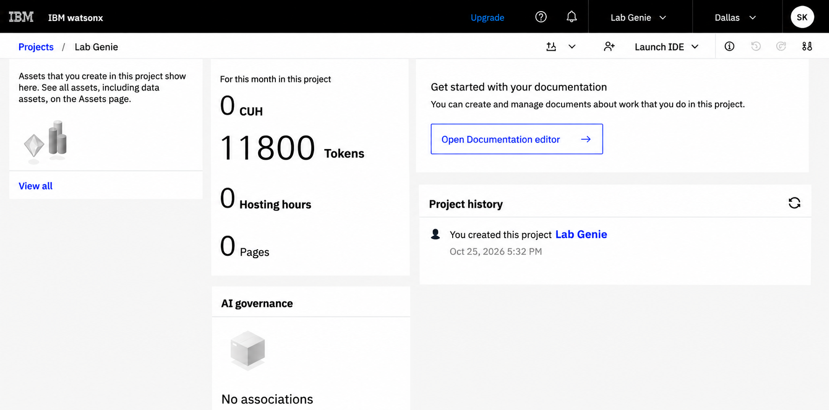
Token Usage
11,761 token are used
Before Prompt
After the Prompt
·
·
·

Slide 11
Novelty and Uniqueness
LabGenie introduces an intelligent, agent-based approach to laboratory manual generation by combining Generative AI, Retrieval-Augmented Generation (RAG), and multi-agent collaboration.
The key novel features include:
Automated Manual Generation: Creates structured laboratory manuals with objectives, theory, requirements, procedures, sample outputs, and conclusions.
Multi-Agent Collaboration: Uses specialized agents for experiment knowledge retrieval, manual generation, code assistance, student support, and content validation.
Context-Aware Content: Generates experiment-specific materials based on subject, laboratory requirements, programming language, and user instructions.
AI-Powered Code Assistance: Provides sample programs, algorithms, and explanations for programming-based experiments.
Interactive Learning Support: Enables students to ask questions and receive explanations related to experiments.
RAG-Based Knowledge Retrieval: Uses relevant academic resources and reference materials to improve the accuracy and relevance of generated content.
Automated Validation: Checks generated manuals for completeness, consistency, and proper structure.
Downloadable Manuals: Converts generated content into organized PDF documents for easy access and academic use.
Faculty-Oriented Support: Helps faculty create, manage, and update laboratory learning materials with reduced manual effort.
Overall Uniqueness:
LabGenie goes beyond simple AI text generation by integrating knowledge retrieval, specialized agents, code assistance, content validation, and PDF generation into a unified platform. It acts as an intelligent laboratory learning and manual preparation assistant for both students and faculty.

Slide 12
Git Hub Link
Please create public github repository (Enable Add README button while creating repository) with format –
Please test and Paste the working Github URL –GitHub - KarimullaShaik96/LabGenie: AI-Powered Laboratory Manual Generator · GitHub
Make sure you have Uploaded following three files into your github repository
1) app.json file , 2) yourproblemstatement.pdf file 3) your projectpresntation.pptx file 4)any other files
·
·
·

Slide 13
Future Scope
Integration with Virtual Labs and Simulation Tools –
LabGenie can be integrated with virtual laboratory platforms and simulation tools to provide students with hands-on practice in a digital environment. Students will be able to perform experiments, observe simulated results, and understand procedures before conducting experiments in physical laboratories. This will enhance practical learning and improve laboratory safety.
AI-Powered Voice Assistant and Multilingual Support –
Enhancing LabGenie with a voice-enabled assistant and support for multiple languages will improve accessibility. Students can ask experiment-related questions and receive explanations in their preferred language. This will make the system more inclusive and useful for learners from diverse linguistic backgrounds.
Integration with Learning Management Systems (LMS) –
LabGenie can be integrated with platforms such as Moodle and Google Classroom to enable faculty to share generated manuals, assign laboratory tasks, and track student progress. This will improve coordination between laboratory learning and academic coursework.
Advanced Experiment Analysis and Result Interpretation –
Future versions can include AI-based tools to analyze experimental data, generate graphs, interpret results, and identify possible errors. This will help students understand experimental outcomes and improve their analytical skills.
Personalized Learning and Adaptive Assistance –
LabGenie can provide personalized explanations, practice questions, and experiment guidance based on each student's learning progress, performance, and level of understanding.
Expanded Knowledge Base and Subject Coverage –
The system can be extended to support more engineering and science subjects, including electronics, mechanical engineering, physics, chemistry, and computer science, using verified academic resources and laboratory datasets.
·
·
·

Slide 14
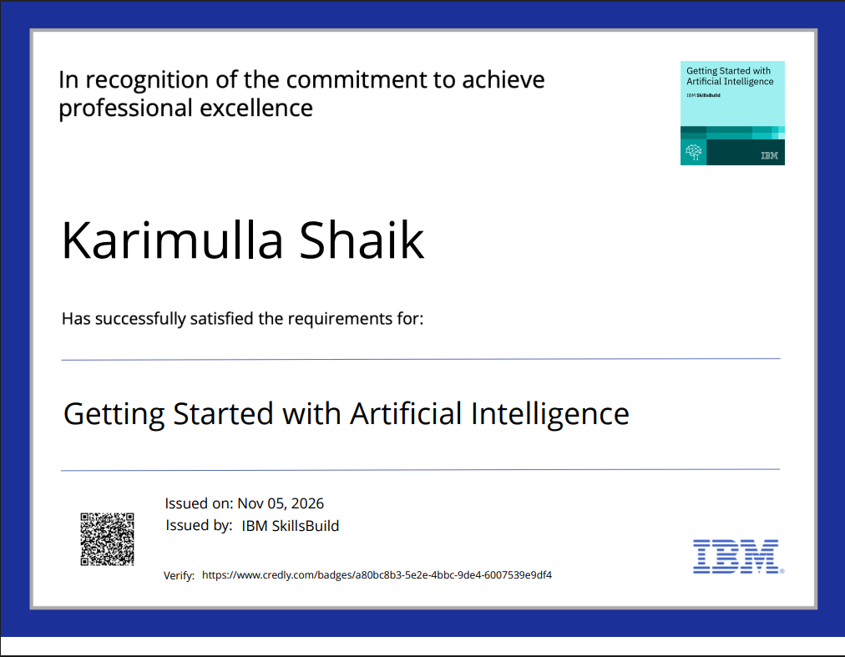
Certificates Earned:
Please add your credly certificate

Slide 15
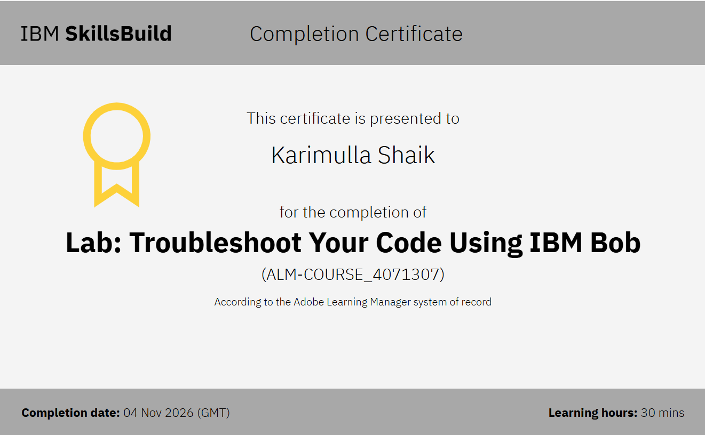
Certificates Earned:​
Add your IBM BOB Certificate

Slide 16


